Slide 1

Welcome to online shopping cart

Slide 2
Internal Guide
Ms. Jasleen Kaur

Slide 3
Team Detail
AMIT KUMAR (11162580)
DEEP SHIKHA (11162588)
RAGHVENDRA TIWARI (11162595)
SHREYASI (11166101)

Slide 4
ABSTRACT
The Customer can Proceed to check as long as his shopping cart is empty. Customer will login to the System, when he proceed to check out, or he can Create account if he not yet have one. He can browse through the product catalogue and add the items through the shopping cart. The order will change to the credit card registered customer’s Account.

Slide 5
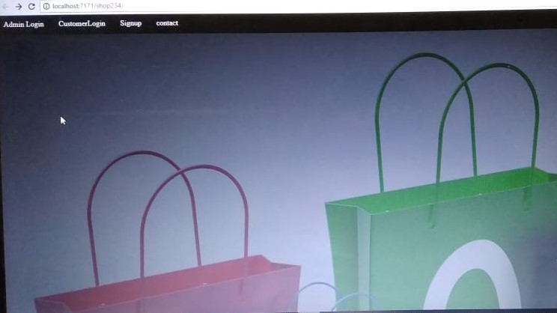
HOME SCREEN

Slide 6
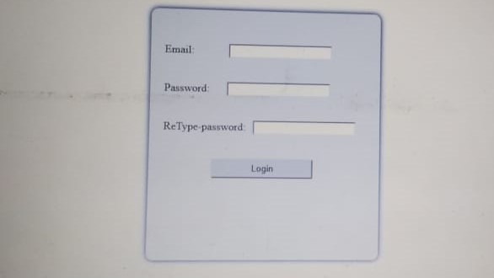
LOGIN PAGE

Slide 7
PROBLEM STATEMENT
Customer can browse through the product catalogue and add the items to shopping cart. He can proceed to check out as long as his shopping cart is not empty. Customer will require to login to the system when he proceed to check out, or he can create an account if he not yet have one. The order will change to the credit card registered in customer’s Account.

Slide 8
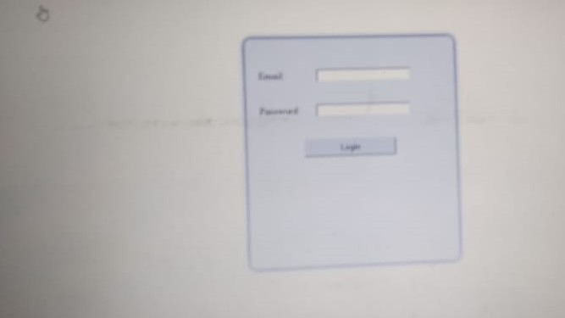
LOGIN TO PAGE

Slide 9
PROBLEM DESCRIPTION
This project provides the software for ONLINE SHOPPING. The purpose of this project is to provide an easy shopping facility online and easy selling facility to the merchants of all Categories.

Slide 10
OBJECTIVE
1: Product Reviews
2: Site Search & Browse
3: Payment Options
4: Wish List/Registry
5: Real-Time Inventory
6: Express Checkout
7: Order Tracking
8: Special Offers
9: Website Security

Slide 11

PRODUCT OF VIEW

Slide 12
TOOLS USED
HTML
CSS
JAVA SERVLET
JQUERY
BOOTSTRAP
H2 DATABASE
JAVA DATABASE CONNECTIVITY
JAVA SCRIPT

Slide 13


